Slide 1
OOPs Concept Training
Topics
Fundamental of OOPs
Encapsulation
Inheritance
Polymorphism
Abstract class
Inner Class
Variables and Final Method

Slide 2
Fundamental of OOPs
The main aim of object-oriented programming is to implement real-world entities, for example, object, classes, abstraction, inheritance, polymorphism, etc.
In object-oriented programming technique, we design a program using objects and classes.
An entity that has state and behavior is known as an object.
An object has two properties-
1. Has Property
2. Does property

Slide 3
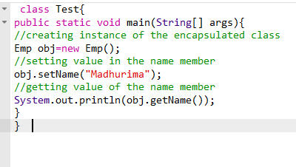
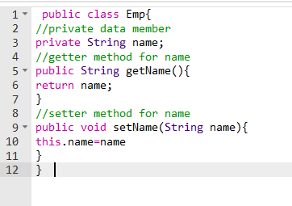
Encapsulation
Encapsulation in Java is a process of wrapping code and data together into a single unit.
We can create a fully encapsulated class in Java by making all the data members of the class private. Now we can use setter and getter methods to set and get the data in it.
Example-

Slide 4
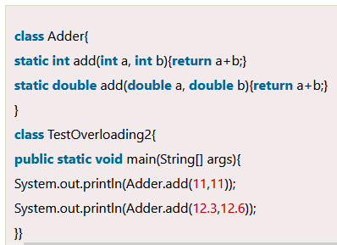
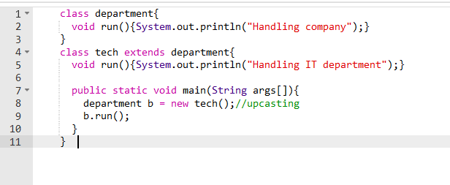
Polymorphism
Polymorphism in Java is a concept by which we can perform a single action in different ways.
There are two types of polymorphism in Java: compile-time polymorphism and runtime polymorphism. We can perform polymorphism in java by method overloading and method overriding.
If you overload a static method in Java, it is the example of compile time polymorphism and an overridden method is called through the reference variable of a superclass.
Example-
QQ- Is Method Overloading is possible by changing the return type of method only?

Slide 5
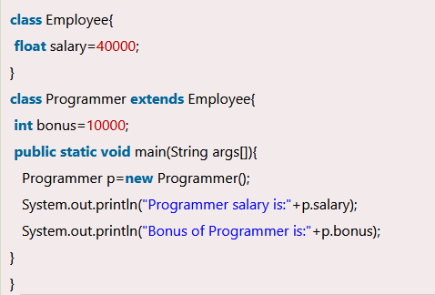
Inheritance
Inheritance in Java is a mechanism in which one object acquires all the properties and behaviors of a parent object.
The idea behind inheritance in Java is that you can create new classes that are built upon existing classes. When you inherit from an existing class, you can reuse methods and fields of the parent class. Moreover, you can add new methods and fields in your current class also
QQ-Practice all type of Inheritance, Does Java support multiple inheritance?
Why? How can we resolve this?

Slide 6
Abstract class
A class which is declared with the abstract keyword is known as an abstract class in java. It can have abstract and non-abstract methods (method with the body).
Abstraction is a process of hiding the implementation details and showing only functionality to the user.
A class which is declared as abstract is known as an abstract class. It can have abstract and non-abstract methods. It needs to be extended and its method implemented. It cannot be instantiated.
Points to Remember
An abstract class must be declared with an abstract keyword.
It can have abstract and non-abstract methods.
It cannot be instantiated.
It can have constructors and static methods also.
It can have final methods which will force the subclass not to change the body of the method.
QQ: what is property class in java?

Slide 7
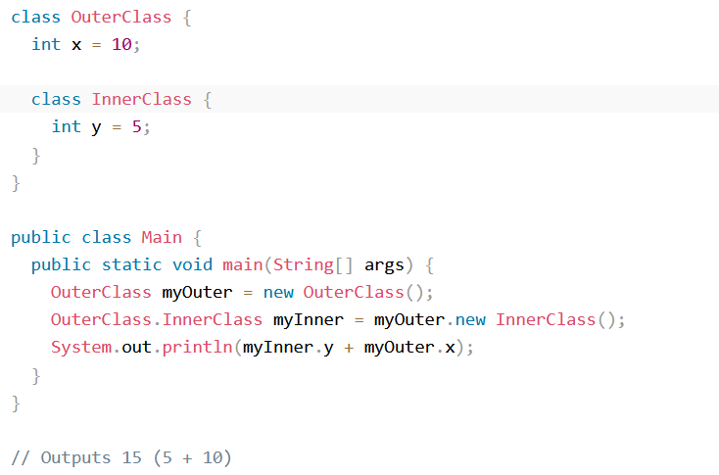
Inner Classes
Inner Class or nested class in Java is a class that is declared inside the class or interface.
Inner classes are used to logically group classes and interfaces in one place to be more readable and maintainable.
Additionally, a non-Static inner class can access all the members of the outer class, including private data members and methods. Below is an example of non-static regular inner class

Slide 8
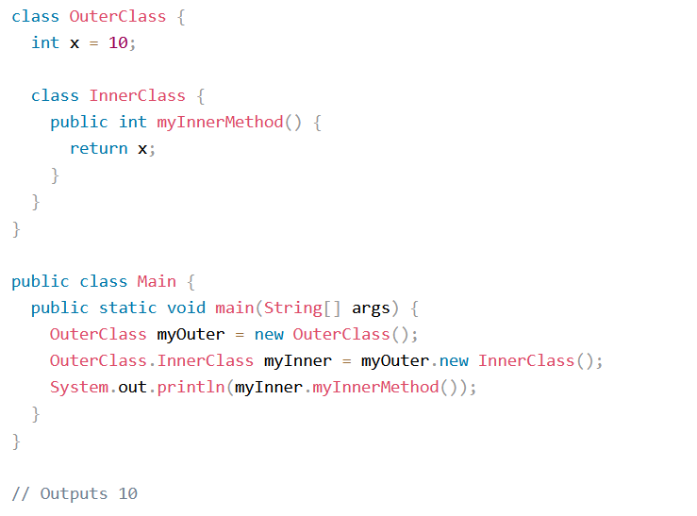
Advantages of using Inner class
Regular non-static inner class can access the attributes and methods of the outer class;Below is an example :

Slide 9
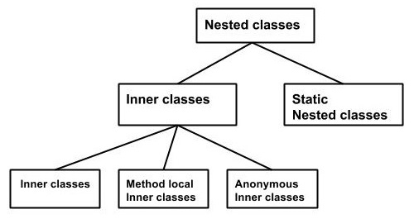
Types of Inner Classes
Nested classes are divided into two types −
Non-static nested classes − These are the non-static members of a class.
Static nested classes − These are the static members of a class.

Slide 10
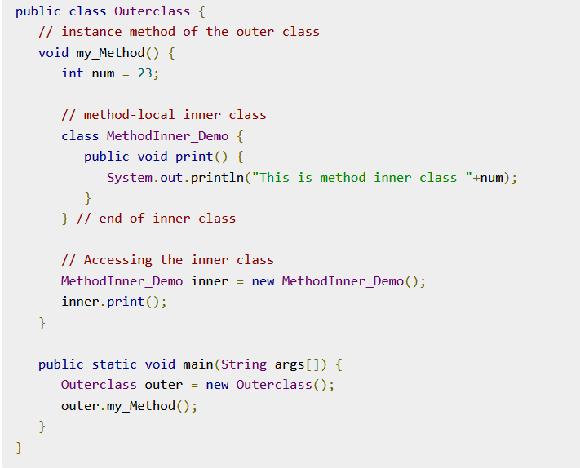

Method local inner class
This is a class within a method of an outer class and will be a local type. Like local variables, the scope of the inner class is restricted within the method. A method-local inner class can be instantiated only within the method where the inner class is defined. Below is an example of method local inner class :
If you compile and execute the above program,
you will get the following result −

Slide 11
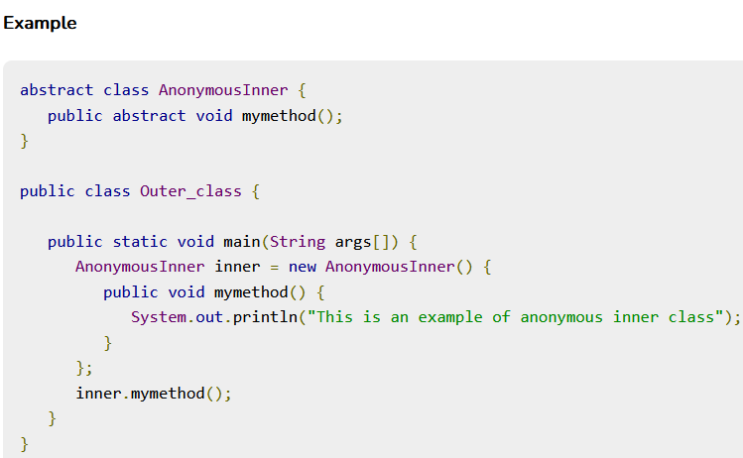
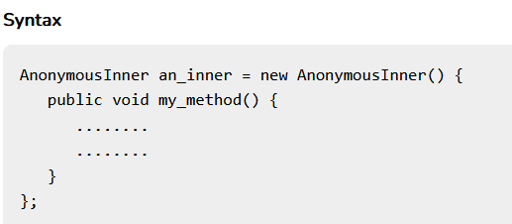
Anonymous Inner Class
An inner class declared without a class name is known as an anonymous inner class. In case of anonymous inner classes, we declare and instantiate them at the same time. Generally, they are used whenever you need to override the method of a class or an interface.The syntax of an anonymous inner class is as follows −
The following program shows how to override the method of a
class using anonymous inner class. The output will be ::

Slide 12
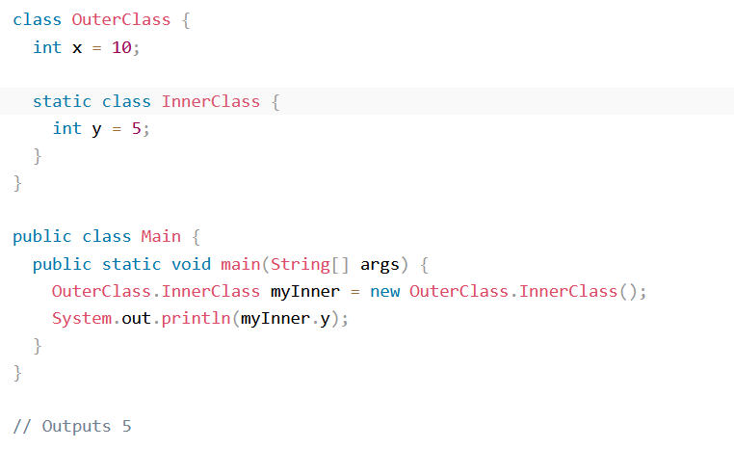
Static nested class
A static inner class is a nested class which is a static member of the outer class. It can be accessed without instantiating the outer class, using other static members. Just like static members, a static nested class does not have access to the instance variables and methods of the outer class. Following is an example of static inner class :

Slide 13
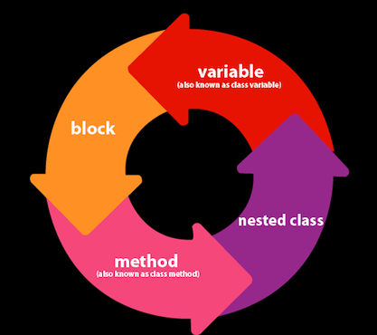
Static Keyword
The static keyword in Java is mainly used for memory management. The static keyword in Java is used to share the same variable or method of a given class. The users can apply static keywords with variables, methods, blocks, and nested classes. The static keyword belongs to the class than an instance of the class. The static keyword is used for a constant variable or a method that is the same for every instance of a class.
The static can be:
Variable (also known as a class variable)
Method (also known as a class method)
Block
Nested class

Slide 14
Java Static Variable
If any variable is declared as static, it is known as a static variable.
The static variable can be used to refer to the common property of all objects (which is not unique for each object), for example, the company name of employees, college name of students, etc.
The static variable gets memory only once in the class area at the time of class loading.
Advantages of static variable
Shared Memory Allocation : It makes your program memory efficient (i.e., it saves memory) as static variables and methods are allocated memory space only once during the execution of the program. This memory space is shared among all instances of the class, which makes static members useful for maintaining global state or shared functionality
Accessible without object instantiation: Static members can be accessed without the need to create an instance of the class. This makes them useful for providing utility functions and constants that can be used across the entire program.

Slide 15
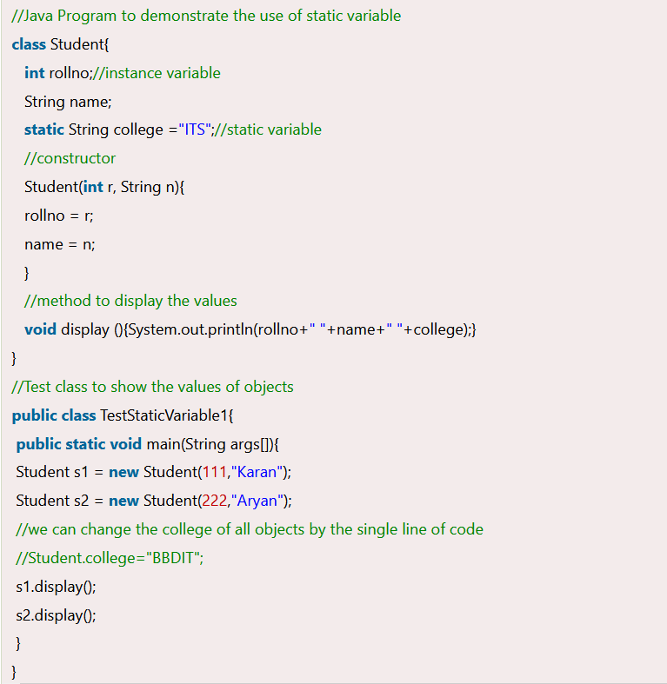

Example of static variable
The following program will have the below output :

Slide 16
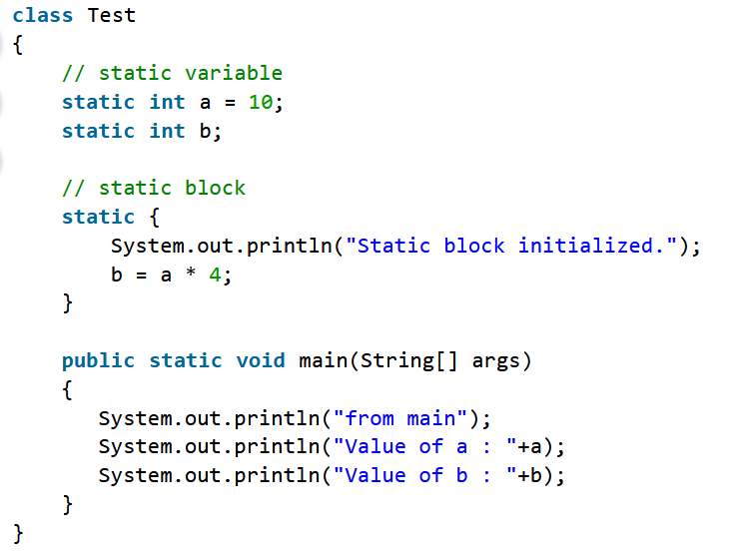
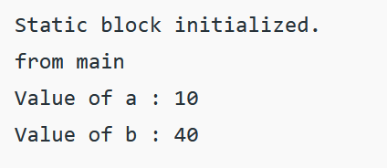
Java Static Block
Whenever static keyword is associated to a block then that block is referred to as a static block.
If you need to do the computation in order to initialize your static variables, you can declare a static block.
This code inside the static block is executed only once: the first time the class is loaded into memory.
in order to call any static block, there is no specified way as static block executes automatically when the class is loaded in memory. Following is an example of a static block :-
Output of the following program will be -

Slide 17
Java Static Method
When static keyword is applied with a method , it is known as a static method . A static method has following properties:
A static method belongs to the class rather than the object of a class.
A static method can be invoked without the need for creating an instance of a class.
A static method can access static data member and can change the value of it.
It can only directly call other static methods.
Following is an example of a static method and how it works :

Slide 18
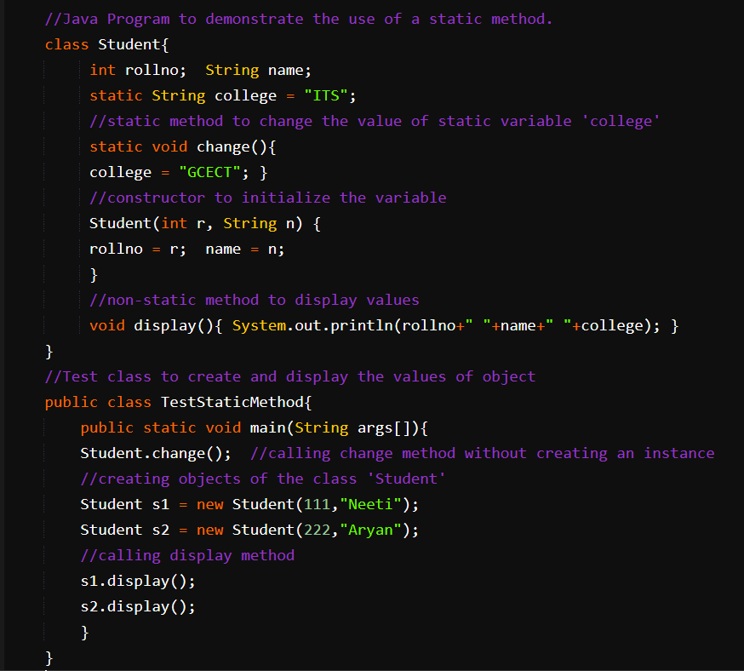

The output of the following program will be -

Slide 19
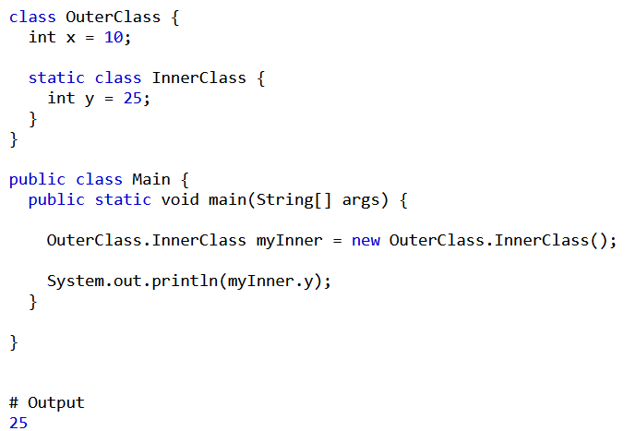
Java Static Class
A class can be made static only if it is a nested class.
We cannot declare a top-level class with a static modifier but can declare nested classes as static. Such types of classes are called Nested static classes.
Nested static class doesn’t need a reference of Outer class.
In this case, a static class cannot access non-static members of the Outer class.

Slide 20
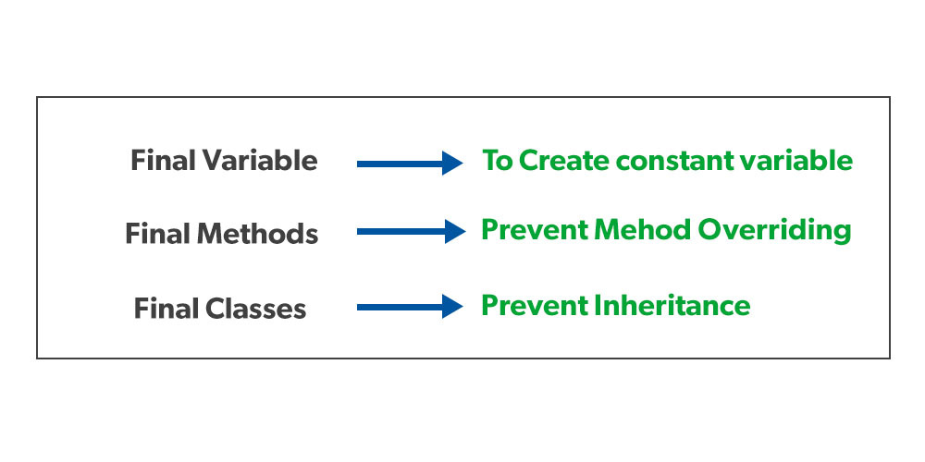
Final Keyword
The final keyword is a non-access modifier used for classes, attributes and methods, which makes them non-changeable (impossible to inherit or override).
The final keyword is useful when you want a variable to always store the same value, like PI (3.14159...).
The following are different contexts where final is used.

Slide 21
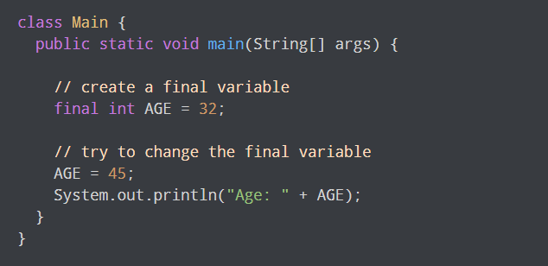

Final Variable
Final variables: When a variable is declared as final, its value cannot be changed once it has been initialized. This is useful for declaring constants or other values that should not be modified.A final variable is called a blank final variable if it is not initialized while declaration.
Following is an example of a final variable and output if we try to reassign the value of a final variable :
The output will be -

Slide 22
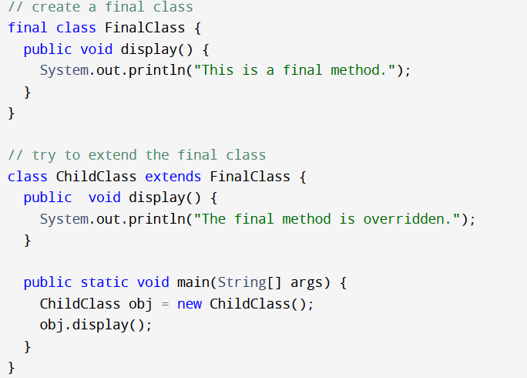

Final Class
When a class is declared with final keyword, it is called a final class. A final class cannot be extended(inherited).
Usage 1: One is definitely to prevent inheritance, as final classes cannot be extended. For example, all Wrapper Classes like Integer, Float, etc. are final classes. We can not extend them.
Usage 2: Create an immutable class like the predefined String class. One can not make a class immutable without making it final.Immutable class in java means that once an object is created, we cannot change its content.
The output of this following program will be :-

Slide 23
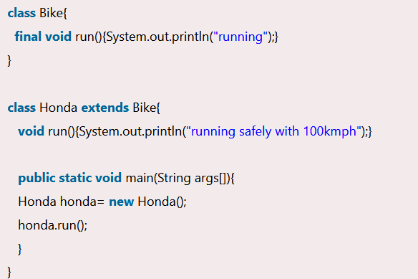
Final Method
When a method is declared with final keyword, it is called a final method. A final method cannot be overridden.We must declare methods with the final keyword for which we are required to follow the same implementation throughout all the derived classes.
The output will be a compile time error as
Class Honda tries to override the final
Method named ‘Bike’ .

Slide 24
Thanks for watching !
Thank You Everyone !

